Slide 1


Management Processes at a Glance
Business Process Management Part 2: Management Processes

Slide 2
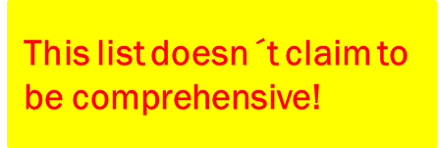
Agenda
INTRODUCTIONAL INFORMATION
Optional Version of SESA´s Future Process Landscape
Framework of Strategy Implementation
DESCRIPTIONS OF MANAGERIAL FIELDS
Vision
Mission
Values
Cultural Management
Business Model Creation
Organisation´s Structure
Organisational Development
Business Strategy
Strategic Planning
Budget Planning
Fund Raising Strategy
Business Development Strategy (Growth)
HR-Strategy

Slide 3
Agenda
DESCRIPTIONS OF MANAGERIAL FIELDS
11. HR-Strategy
12. Diversity Management
13. IT Strategy
14. IT Governance
15. IT Service Management
16. Product Strategy
17. Quality Management System
18. Risk Management System
19. Performance Management
20. Innovation Management
21. Change Management
22. Communication Strategy
23. Continuous Improvement
24. Project Management

Slide 4
Descriptions of Managerial Fields

Slide 5
Management Processes
Draft: Process Landscape of SESA Georgia
Strategy
HR-Processes
Operational Control
Budget
Risk Management
Quality Management
Core Processes
Consulting &
Mediation
Promotion Payments
Livelihood Payments (e.g.
SSA)
Jobseeker
Employer
The future starts right now! What kind of Organisation is SESA meant to be in the future?
Training Providers
Others
Supporting Processes
IT
Infrastructure
Finance
Internal Control
Audit
Marketing

Slide 6
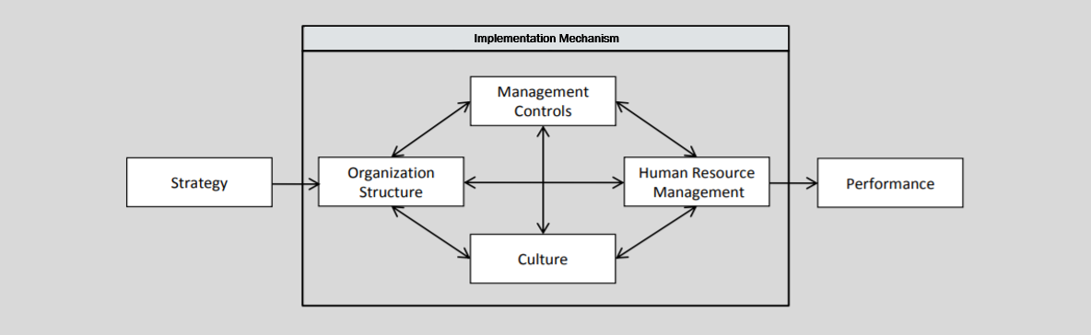
Framework of Strategy Implementation

Slide 7
Descriptions of Managerial Fields

Slide 8
Vision
The Vision Statement defines a desired goal for the future and exemplifies the long-term development of the organization. The effort must be challenging, but not unrealistic and therefore not credible. The Vision Statement should contain three answers. The Vision Statement should be short and concise.
What are we doing?
Why are we doing this?
For whom are we doing it?

Slide 9
MIssion
The mission statement describes how the organization intends to achieve its long-term goal. In doing so, the organization also brings in the type of products and services - ideally also the unique selling proposition. The mission statement should be as short and concise as possible and express how the organization intends to fulfill its vision. Example: We work daily to achieve our vision (goal?) by year (2021???) by building a Digital Service Platform (how/what).
What is our goal?
When will we achieve this goal?
How do we want to achieve this goal?
Source: https://www.wir-machen-kommunikation.de/blog/vom-vision-zum-mission-statement

Slide 10
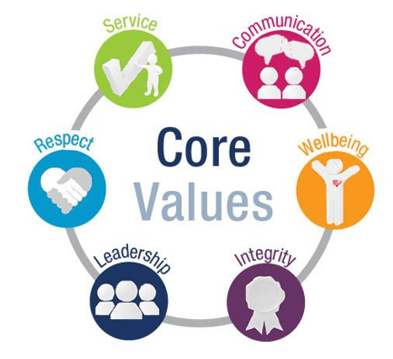
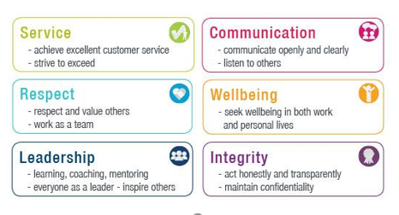
Values

Slide 11
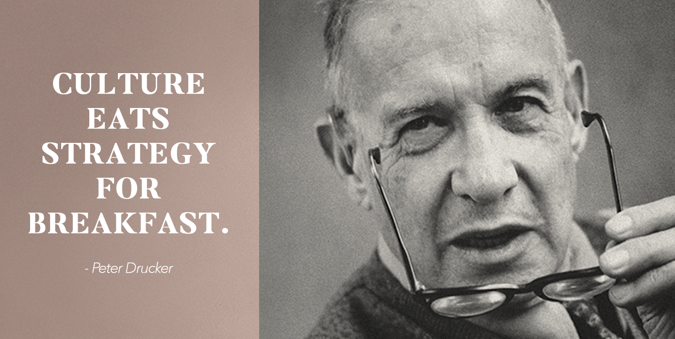
Peter Drucker (1909-2005) was one of the most widely-known and influential thinkers on management, whose work continues to be used by managers worldwide.

Slide 12
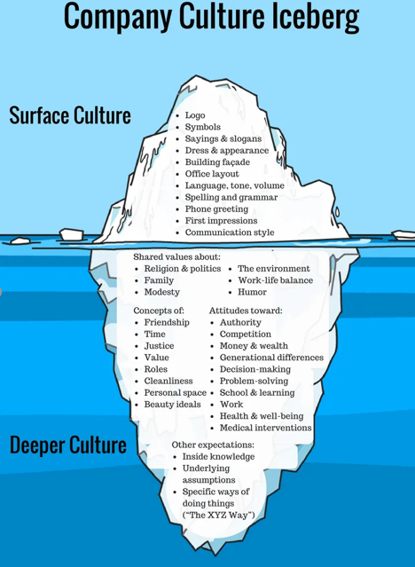
Cultural Management

Slide 13
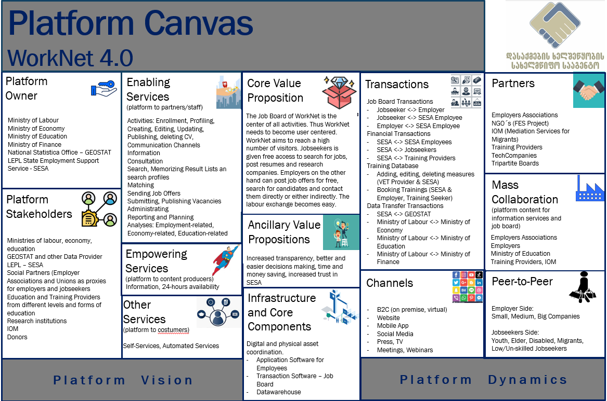
Business Model Creation Process

Slide 14
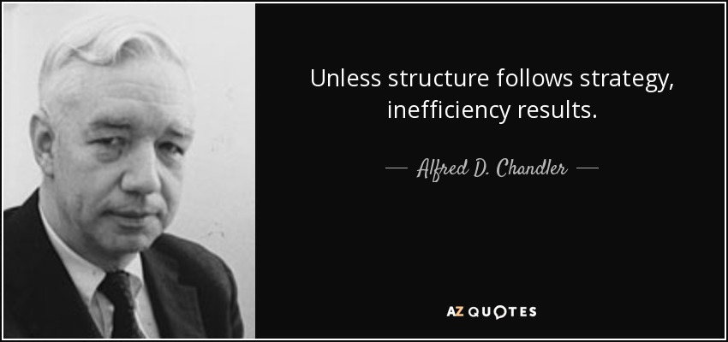
Alfred DuPont Chandler (September 15, 1918 – May 9, 2007) was a professor of business history at Harvard Business School and Johns Hopkins University, who wrote extensively about the scale and the management structures of modern corporations/organizations. His works redefined business and economic history of industrialization.

Slide 15
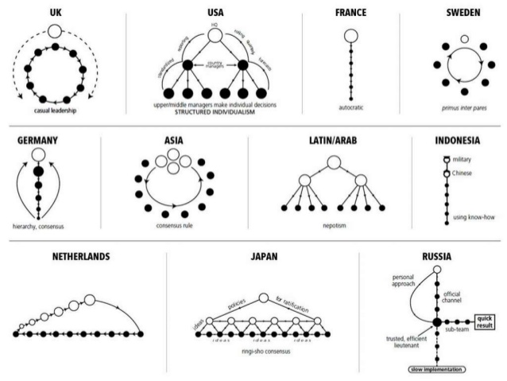
Structure
Structure follows strategy
is a business principle that states that the divisions, departments, teams, processes and technology of an organization are designed to achieve an organisation´s
strategy. This may seem obvious but in practice the opposite often happens. (Interface to Business Model!!!)
This picture is meant as a Joke.

Slide 16
Organisational Development
What is meant by organizational development?
Organizational development aims at:
- Changing individual behavior patterns,
- Attitudes and skills of the organization members (personal)
- Organizational and communication processes (procedural)
- Structural regulations e.g. working time, work organization, wage forms (structural)
Organizational development (OD) basically has two main areas
- one that concerns the personnel and
- one that affects technological changes.
The transitions between these areas of OD are fluid, since technological changes usually also affect personnel.
Mandates of the organizational development departments are:
Optimization of workflows and processes
Goal-oriented realignment within employee teams
Increase of flexibility, willingness to change and innovation
Improvement of the motivation of the employees
Technological changes.
Source: https://www.landsiedel-seminare.de/coaching-welt/wissen/coaching-themen/organisationsentwicklung.html#prozess

Slide 17
Business Strategy
A business strategy is a roadmap for achieving organisation´s goals. It establishes a set of principles that concerns organisation's priorities, decisions, and actions.
Identify your organisation's aspirations and set goals to measure progress toward achieving that aspiration.
Pinpoint which Customer Segments should benefit from your products and services. Which customer Segments should use your system.
Figure out which competencies are needed to offer successfully products and services to these customers in order to build on organisation’s success.
Decide which management systems are needed to hone these competencies.

Slide 18
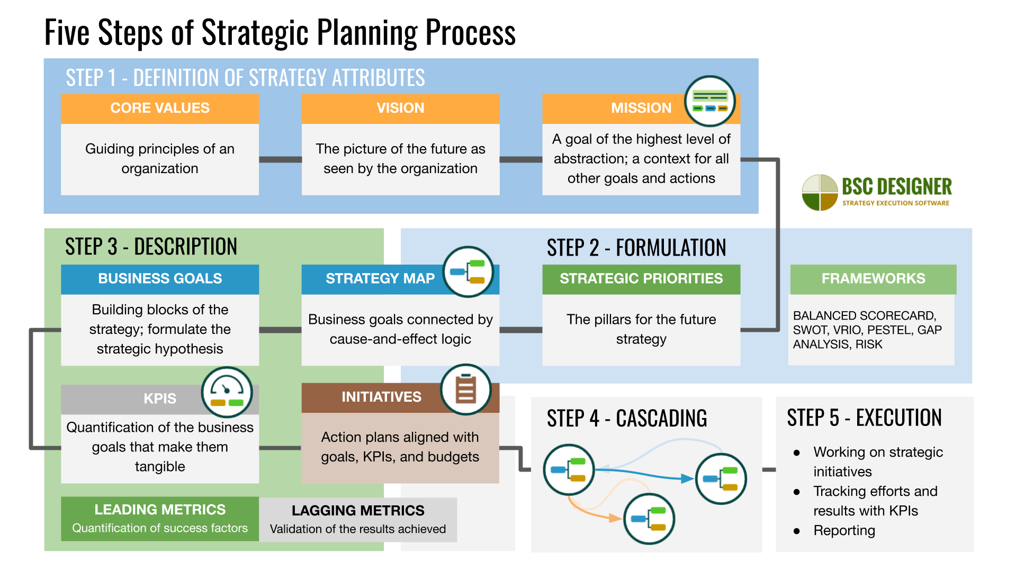
Strategic Planning

Slide 19
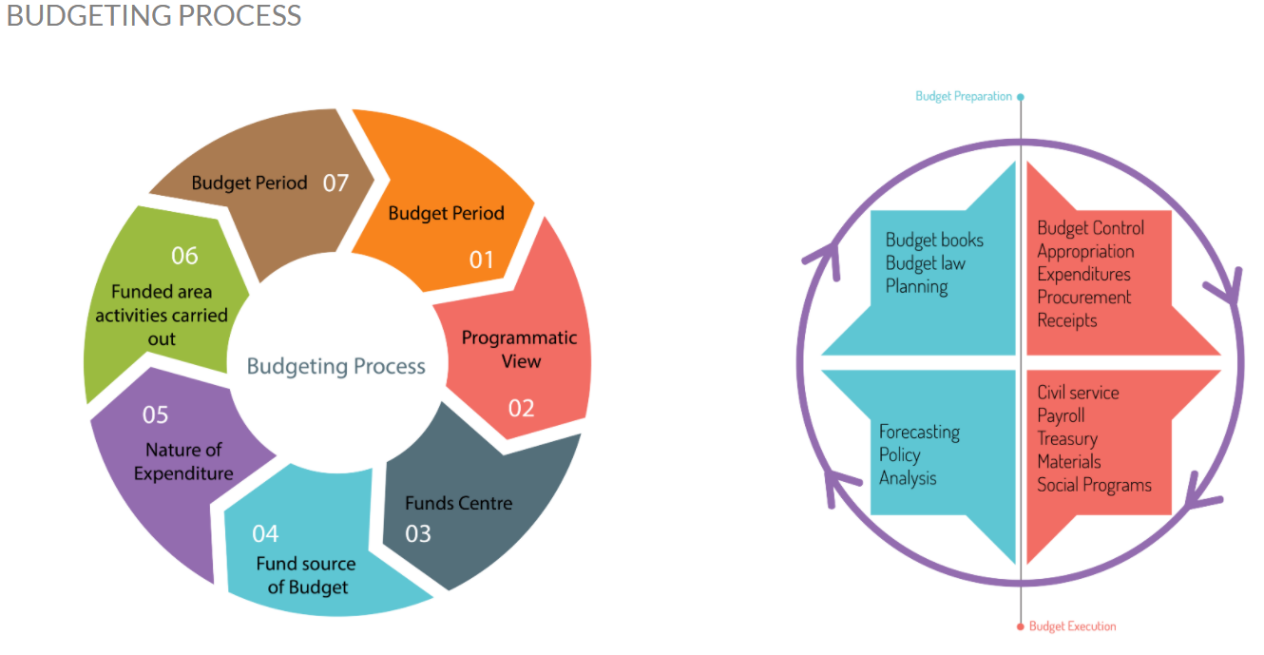
Budget Planning
Source: http://www.oneclicksolutions.com.sg/Budget-Control-Tool.html

Slide 20
Fund Raising Strategy
A fundraising strategy is a plan which sets out:
what your organisation was set up to do and its main areas of work
what your funding needs and priorities are over the coming period of time
where you will raise it from (potential donors or loan providers, your own budget plan, the ministry of finance, savings from other projects)
how you intend to raise that money (activities)
Go for small as well as large amounts of money, but don´t get distracted!
Chase funding partners which fit your purpose.
Set timescales and try to keep to them.
Sustainable funding
Once you have set out what you want to achieve and how much money you will need approximately, stay tuned with the potential donors to make sure you are getting funds (e.g. contracting)

Slide 21
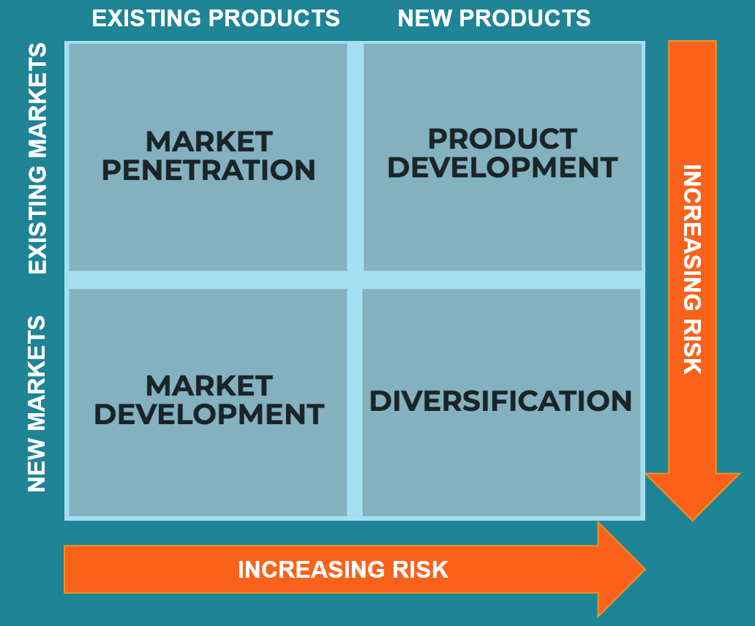
Business Development Strategy
This is the Ansoff* Matrix, also called the Product/Market Expansion Grid, this is a tool used by firms and organizations to analyze and plan their strategies for growth. The matrix shows four strategies that can be used to help a firm/ an organisation grow and also analyzes the risk associated with each strategy.
* Harry Igor Ansoff (1918- 2002) was a prominent Russian American mathematician and scientist. He is known as the father of Strategic management and his development of the strategy model, the Ansoff matrix .

Slide 22
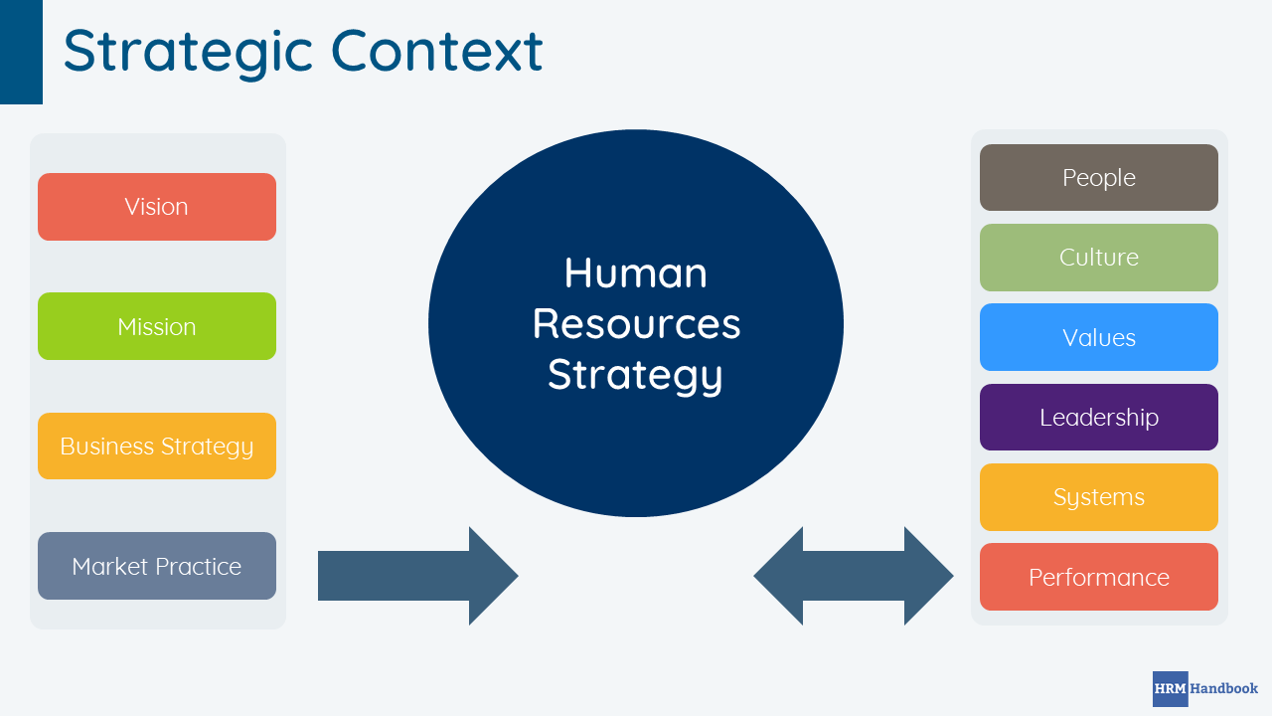
HR - Strategy
Source: https://hrmhandbook.com/hrm/hr-strategy/

Slide 23
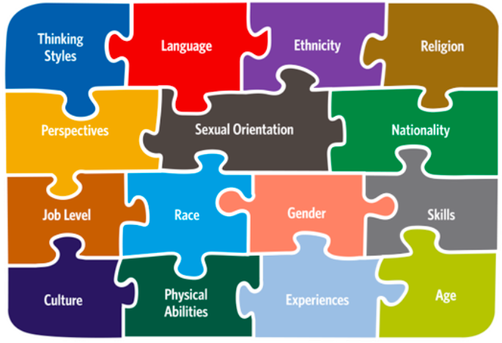
Diversity Management

Slide 24
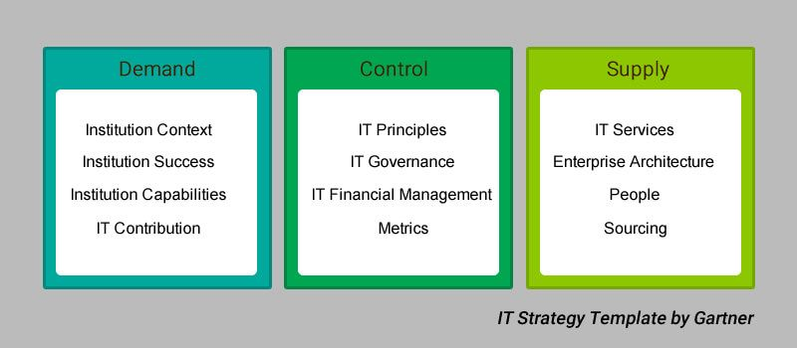
IT – Strategy
Source: https://www.heliossolutions.co/blog/how-to-create-an-it-strategy-that-will-help-your-business-win/

Slide 25
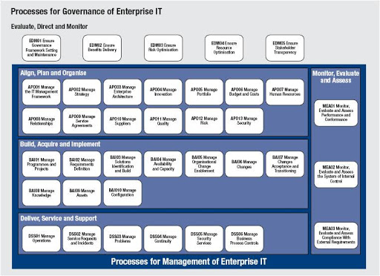
IT – Governance
COBIT 5
Framework
IT Governance
is a process used to monitor and control key information technology capability decisions - in an attempt - to ensure the delivery of value to key stakeholders in an organization.

Slide 26
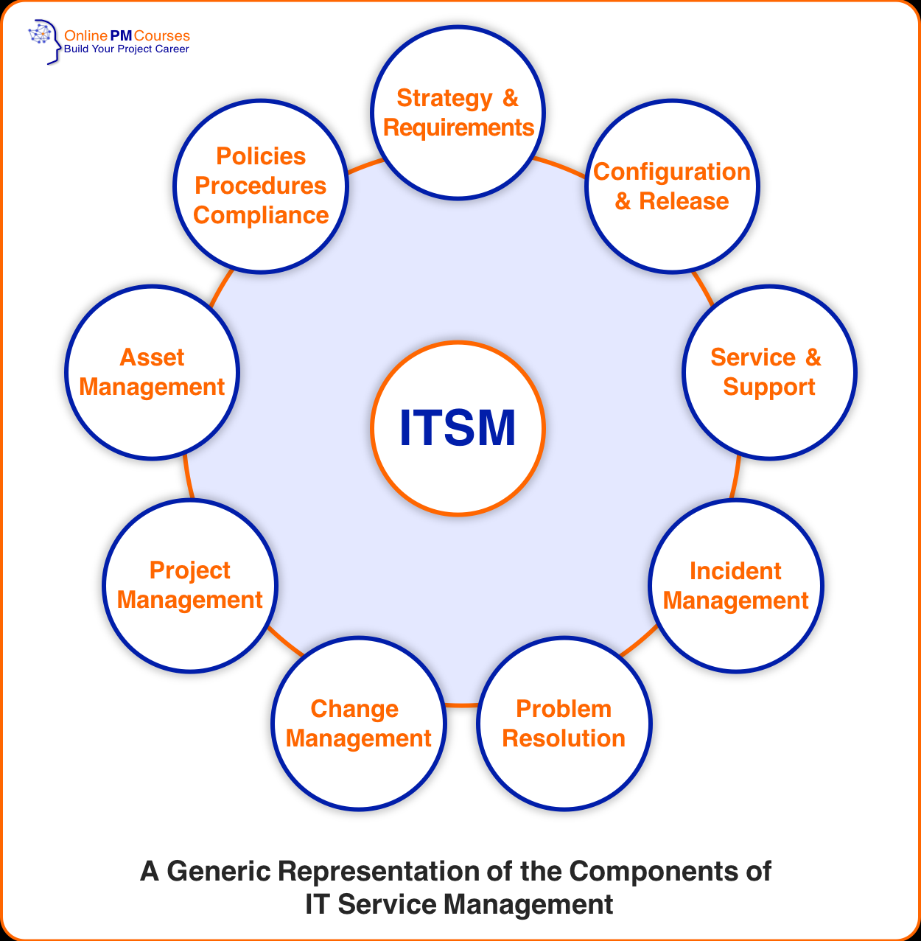
IT Service Management Strategy
ITIL 4,
formerly an acronym for Information Technology Infrastructure Library, is a set of detailed practices for IT service management
(ITSM) that focuses on aligning IT services with the needs of business.

Slide 27
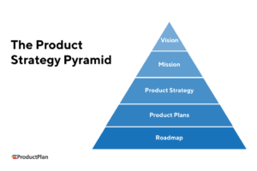
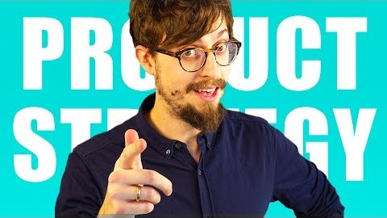
Product - Strategy
Product
User Persona Development
-> Supporting Process
Youtube Explainer Video Product Management:

Slide 28
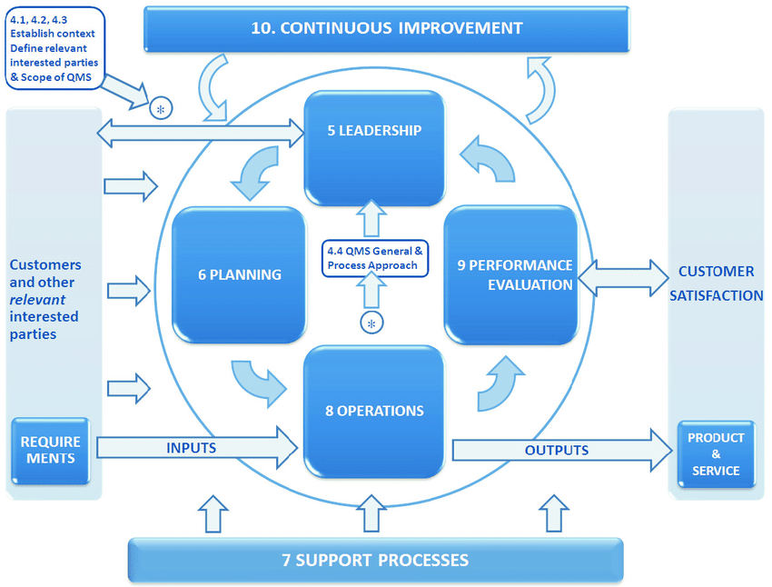
Quality Management System
Source: https://www.iso.org/home.html

Slide 29
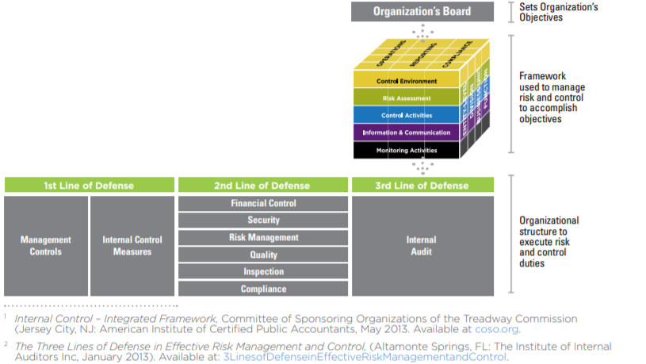
Risk Management – COSO ERM

Slide 30
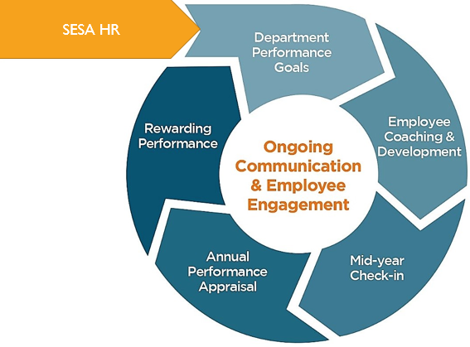
Performance Management
Performance management (PM) is the process of ensuring that a set of activities and outputs meets an organization's goals in an effective and efficient manner. Performance management can focus on the performance of an organization, a department, an employee, or the processes in place to manage particular tasks.

Slide 31
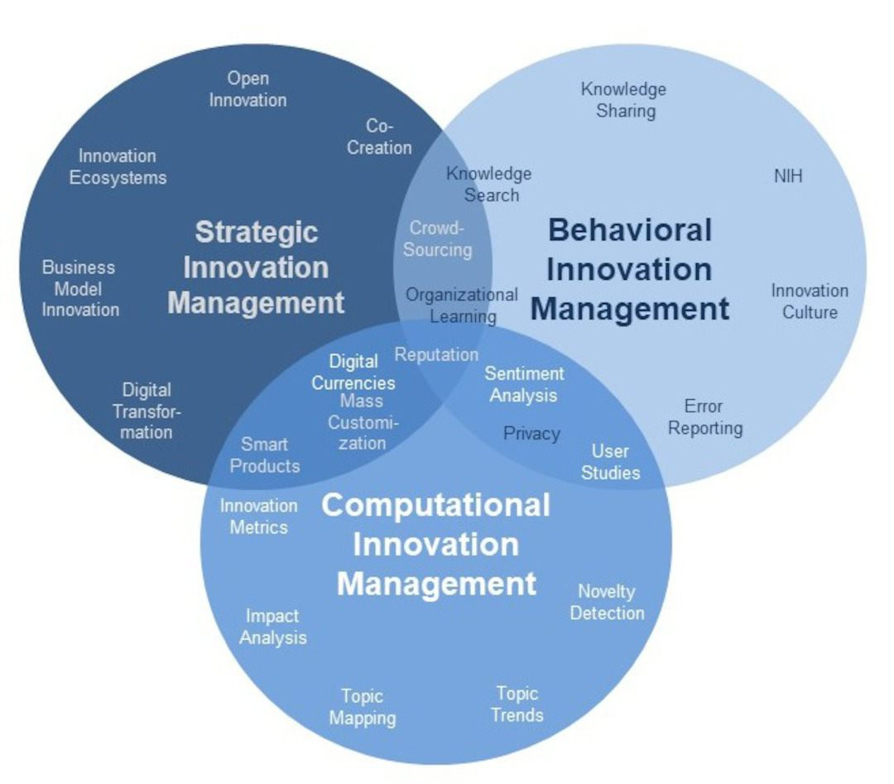
Innovation Management
Please watch the interactive Prezi Presentation:
https://prezi.com/view/NbxNrWOQnYuWdwiscz2W/

Slide 32
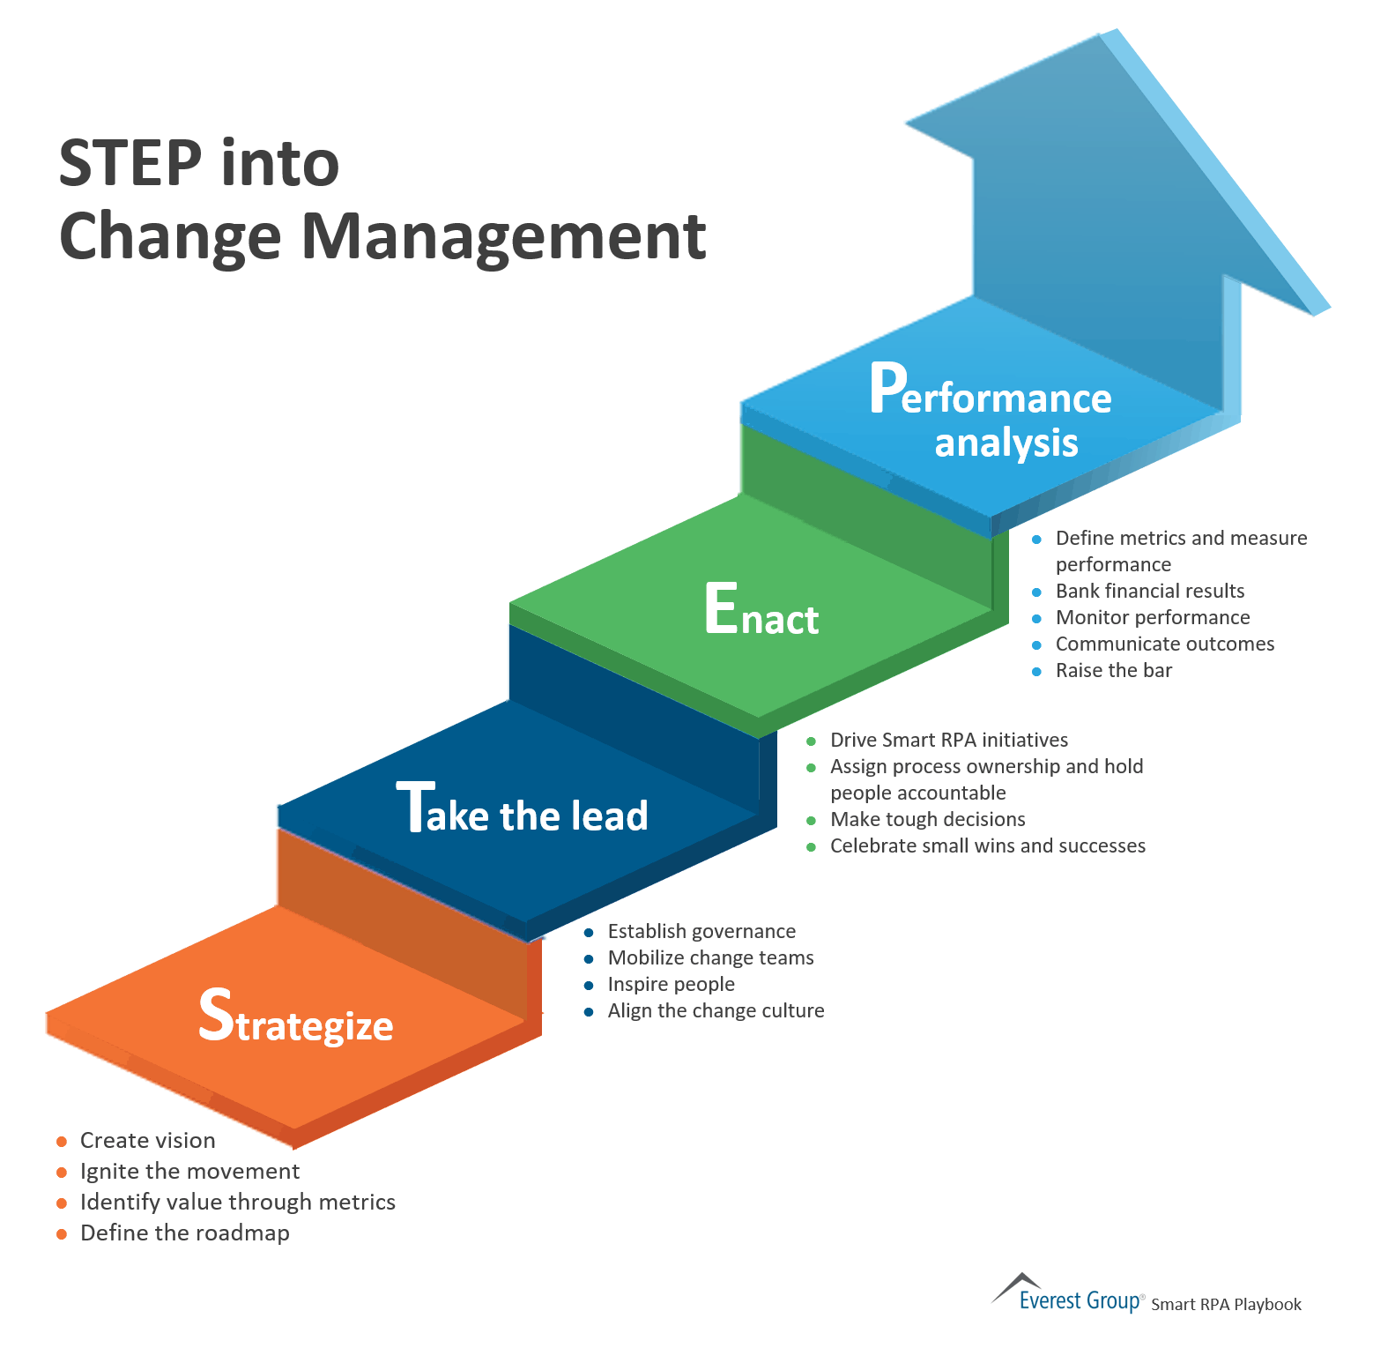
Change Management
IT-Change Management
Organisation Change Management

Slide 33
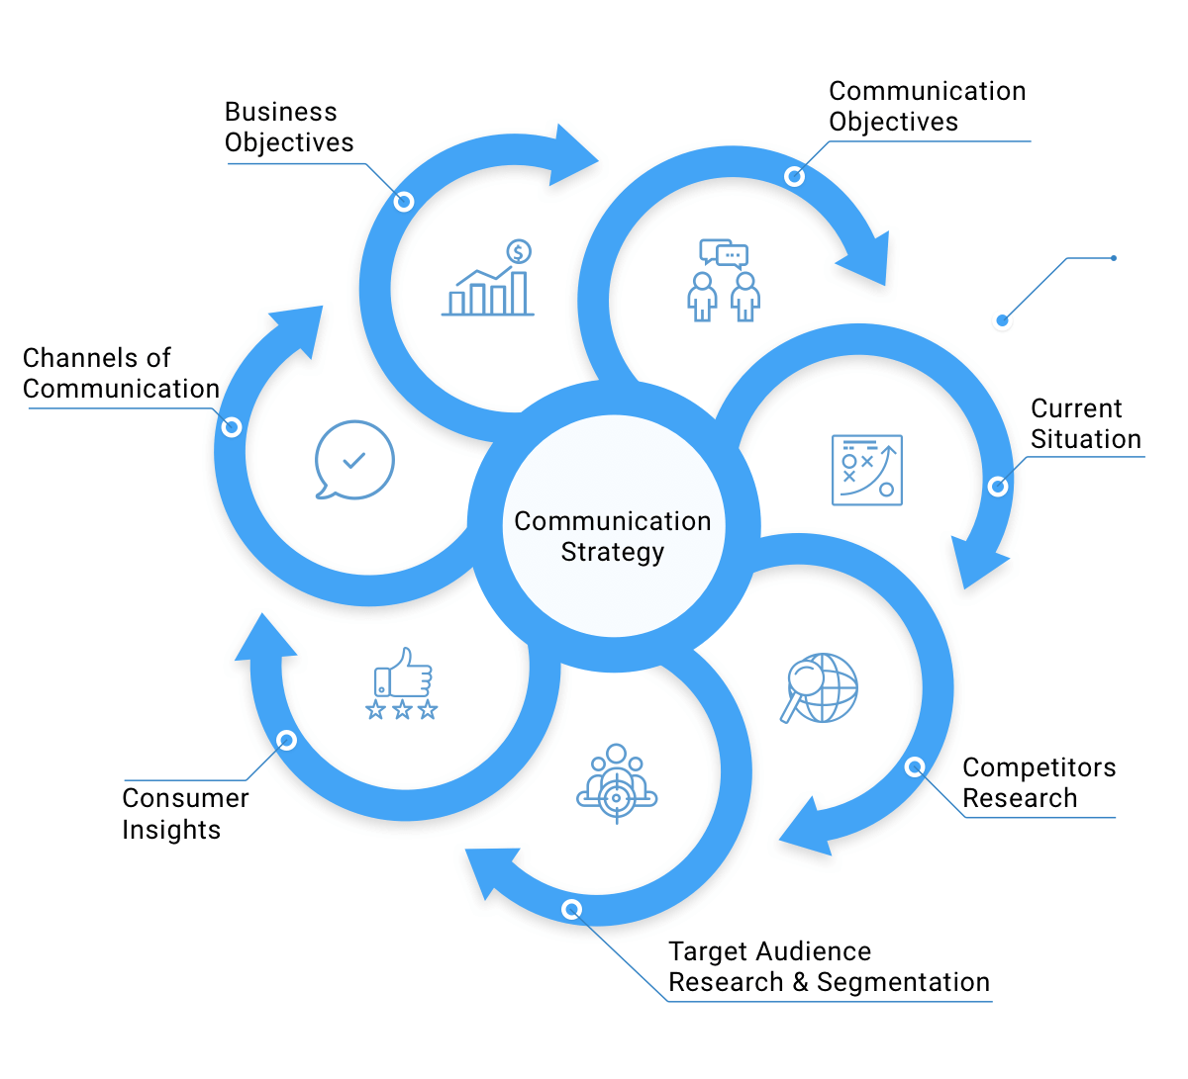
Communication Strategy

Slide 34
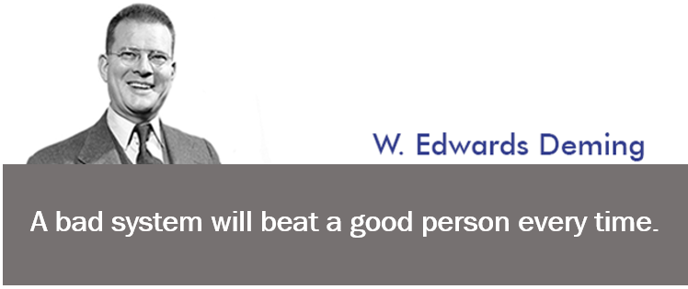
Continual Improvement
William Edwards Deming (1900-1993) is widely acknowledged as the leading management thinker in the field of quality. He was a statistician and business consultant whose methods helped hasten Japan's recovery after the Second World War and beyond.

Slide 35
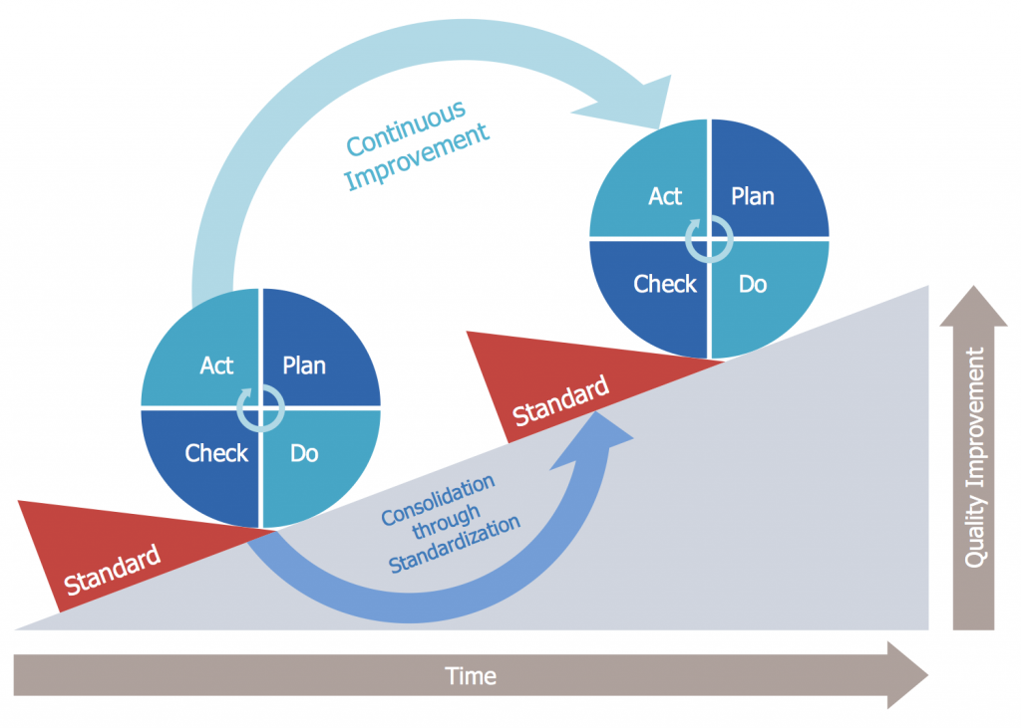
Continual Improvement
This graphic shows the Deming* Cycle which is part of QM.
The Deming Cycle stands for Kaizen (bottom up improvement).

Slide 36
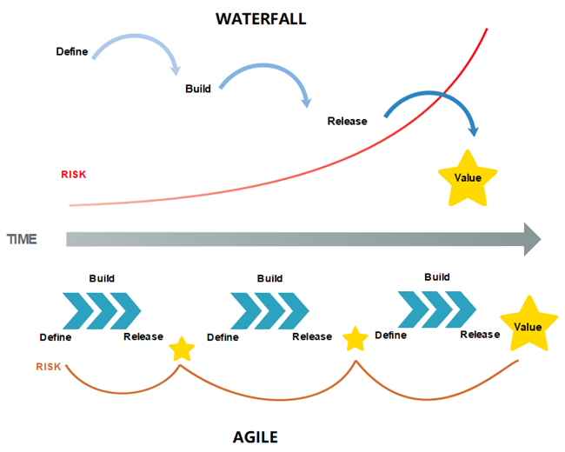
Project Management

Slide 37
Contact
Susanna Burkert
Integrated Expert for Migration Governance, Labour Market Policies and Digitalisation Phone: +995 558 16 27 86
Phone: +49 176 814 848 53
Mail: susanna.burkert.sb@gmail.com
Ministry of IDPs from the Occupied Territories,
Labour, Health and Social Affairs
144 Tsereteli Avenue, 0119 Tbilisi, Georgia

Slide 38
Thanks for your Attention!

